Slide 1
Home Credit Risk
GROUP 1:
Shweta Chaudhari
Nishant Gandhi
Haoan Yan

Slide 2


Our target
AIM: Predict how capable each applicant is of repaying a loan
TASK:
Data cleaning and processing
Compare
Linear Regression
Decision Tree Regression
Random Forest Regression
Extreme Gradient Boost Regression
SVM
Find RMSE value
Target:
0: Can repay loan
1: Cannot repay loan

Slide 3
Data Clean
Categorical
Hot Coding
Feature Importance
Data
Set
Drop by Missing
Drop by Importance
Numerical
Fill Missing

Slide 4
Build models
Standardization
Linear Regression
90% Train
Prediction
Numerical
To
Categorical
Decision Tree
Random Forests
Cleaned Data Set
XGBoost
SVM
RMSE
Confusion Matrix
Standardization
10% Test

Slide 5
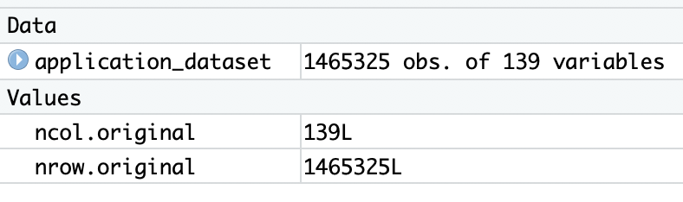
Data PREP
Join application_train.csv & bureau.csv -> 1,465,325 rows， 139 cols
After drop the ID and foreign ID, the merged dataset has 137 independent variables and 1 dependent variables with over 1.4 million records. These 137 features are either continuous, discrete or categorical in nature.
Calculate Missing Rate
Drop the columns whose Missing Rate > 50%

Slide 6
Drop columns over 50% missing

Slide 7
Categorical VS numerical

Slide 8
Numerical data
Most of the missing values are filled with the average number of the column
Some of the columns fill the missing values with 0. such as AMT_CREDIT_SUM_DEBT, DAYS_CREDIT_ENDDATE, AMT_CREDIT_SUM_LIMIT
OWN_CAR_AGE (Over 50% missing, dropped at first)
EXT_SOURCE_3 | APT_AVG | CREDIT_DEBT
NA | 0.095 | 2440057
0.311 | NA | 0
0.083 | 0.024 | NA
EXT_SOURCE_3 | APT_AVG | CREDIT_DEBT
AVG | 0.095 | 2440057
0.311 | AVG | 0
0.083 | 0.024 | 0

Slide 9
Categorical Data
Some of the numerical data in R should be regarded as categorical.
TARGET
0
1
Categorical
FLAG_PHONE
0
1

Slide 10
Categorical Data
NAME_FAMILY_STATUS_Married
One-hot encoding the categorical data to numerical one
NAME... _Single | NAME… _Married | NAME… _Civil… | NAME… _Widow | NAME… _Separated | NAME_
1 | 0 | 0 | 0 | 0 | 0
1 | 0 | 0 | 0 | 0 | 0
0 | 1 | 0 | 0 | 0 | 0
0 | 1 | 0 | 0 | 0 | 0
0 | 0 | 1 | 0 | 0 | 0
0 | 0 | 0 | 1 | 0 | 0
0 | 0 | 0 | 0 | 1 | 0
0 | 0 | 0 | 0 | 0 | 1
NAME_FAMILY_STATUS
Single
Single
Married
Married
Civil Marriage
Widow
Separated
NA

Slide 11
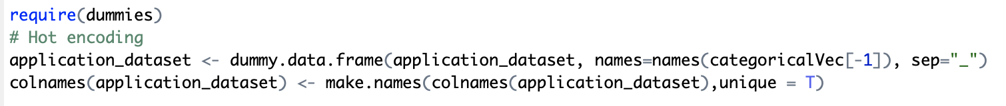
Categorical Data
Hot encode is implemented by dummies package.
Solve the problem with column names with make.names() function
Punctuation and space ‘ ’
may ruin Everything

Slide 12
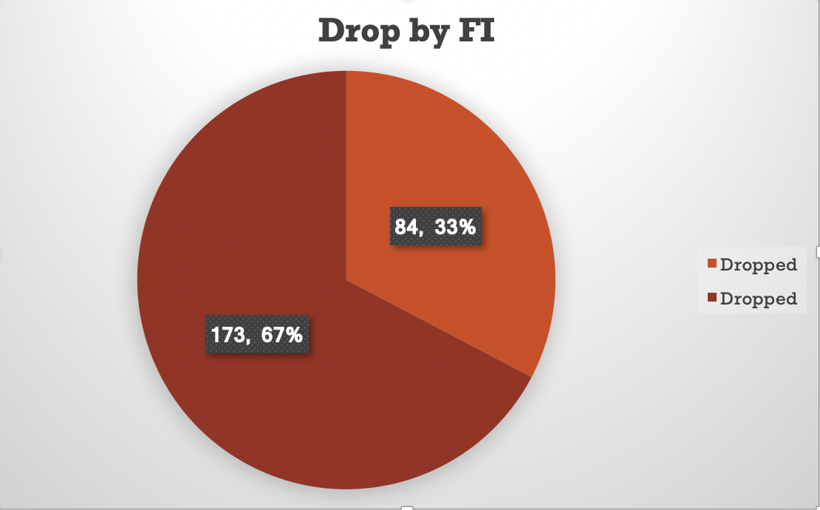
Feature Importance
Here is the feature with TOP 30 Feature Importance.
We drop the features with FI < 10^(-3)

Slide 13
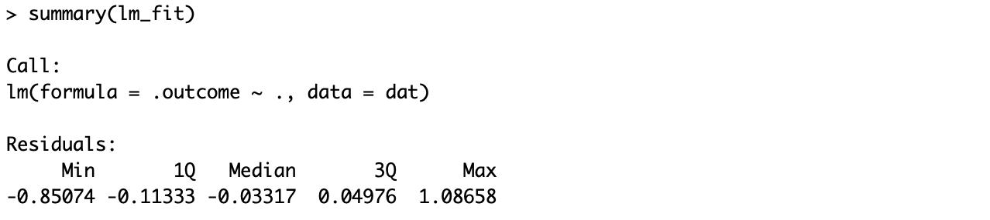
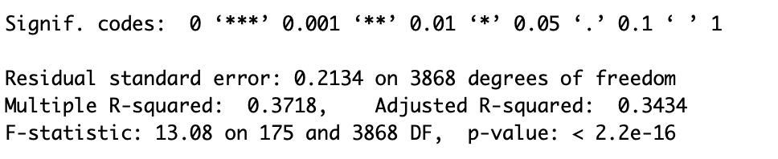
Multiple linear regression
Multiple Linear Regression is the most common form of linear regression analysis

Slide 14
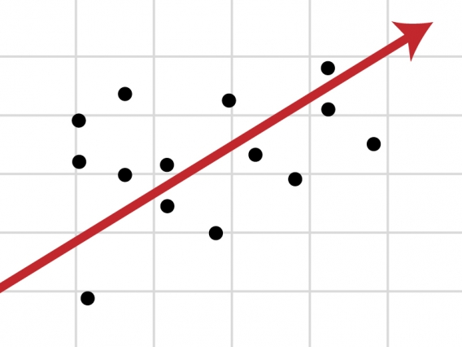
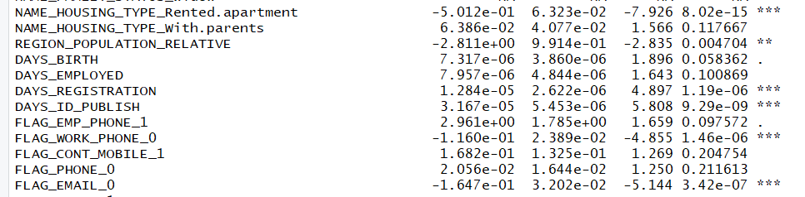
Linear regression

Slide 15

DECISION TREE
Decision tree builds regression or classification mode in the form of tree structure.
It breaks down dataset into smaller subset and final result is a tree with decision node and leaf node.
Root node is the best predictor.
It handles both categorical and numerical values.
It is supervised learning method used to predict target variable.

Slide 16
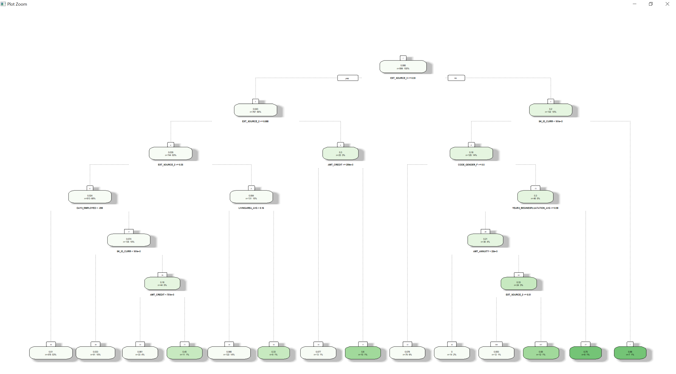
Decision tree

Slide 17

Random forests
Also known as random decision forest.
It is an ensemble learning method for classification,regression.
Random forest is bagging technique (trees are run in parallel).
Usage: randomForest(formula, data)
where,
formula = describe the predictor and response variable.
data = name of dataset used.

Slide 18
Extreme Gradient Boost
XgBoost uses gradient boosting decision tree algorithm.
It is an implementation of gradient boosted decision trees designed for speed and performance.
Predicts the residual, error and prior models and add them to make a final prediction.

Slide 19
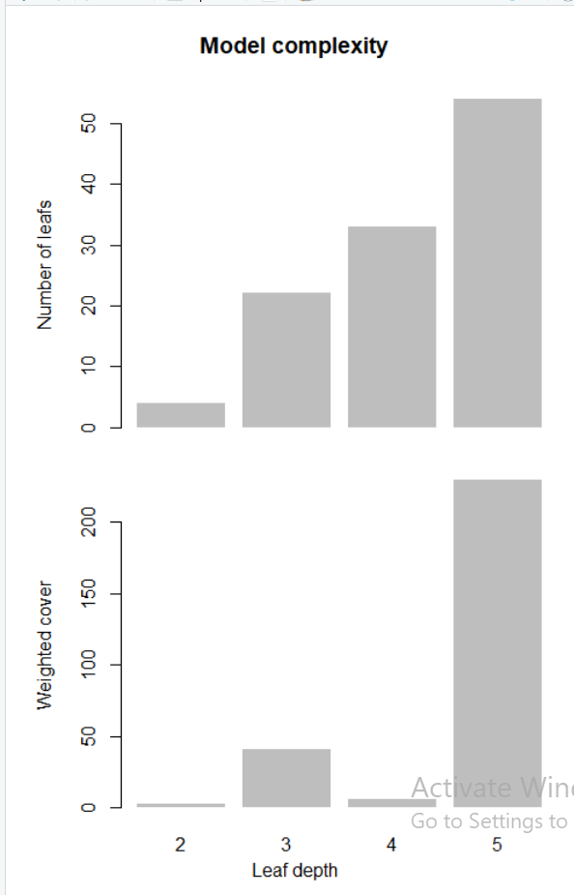
DeepNESS
Function: xgb.plot.deepness
Upper Plot: Number of leaves per level of deepness.
Lower Plot: Normalized weighted cover per leaf (weighted sum of instance).
2nd and 4th level not many leaves

Slide 20
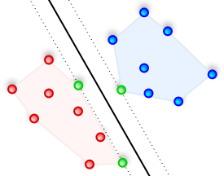
SVM
SVM(Support Vector Machines)
Supervised learning models with associated learning algorithms that analyze data used for classification and regression analysis.
Builds a model that assigns new examples to one category or the other, making it a non-probabilistic binary linear classifier.
SVMs can efficiently perform a non-linear classification using what is called the kernel trick.

Slide 21
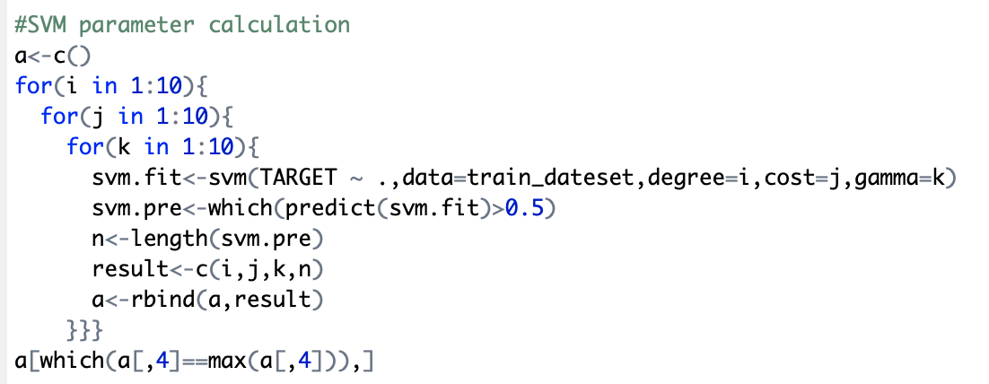
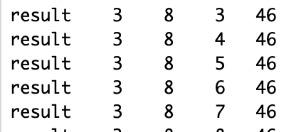
SVM Parameters
Loop the combination of degree, cost and gamma, choose one with best performance and proper gamma.

Slide 22
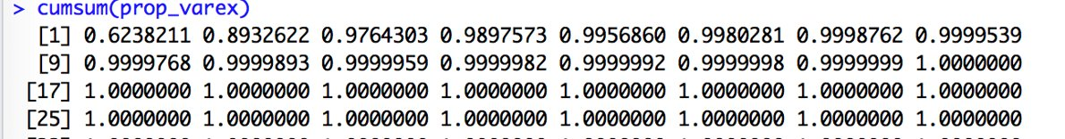
PRINCIPAL COMPONENT Analysis: Dimension reduction
prcomp() method of R to perform PCA
Categorical features are one-hot-codded
Standardization on Numerical features
Top 15 components presented 99% of the variance in dataset

Slide 23
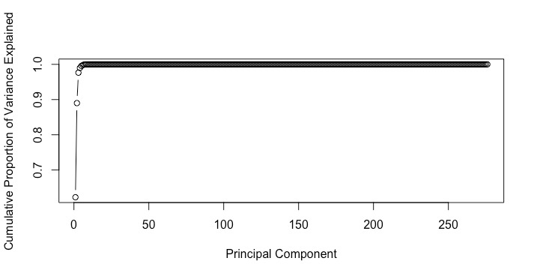
PRINCIPAL COMPONENT ANALYSIS

Slide 24
rmse
Root Mean Square Error -> Computes the root mean squared error between the two numeric vectors.
Usage: rmse (actual, predicted)
Linear Regression: RMSE value = 0.1059875
Decision Tree: RMSE value =0.2402279
Random Forest: RMSE value =0.08856028
Extreme Gradient Boost: RMSE value = 0.1935051
SVM RMSE value = 0.2350091
Linear Regression with PCA = 0.2236068

Slide 25
CONFUSION MATRIX
Linear Model | Actual : 0 | Actual : 1
Predicted : 0 | 0.94 | 0
Predicted : 1 | 0.01 | 0.05
XG Boost | Actual : 0 | Actual : 1
Predicted : 0 | 0.94 | 0
Predicted : 1 | 0.01 | 0.05
Decision Tree | Actual : 0 | Actual : 1
Predicted : 0 | 0.94 | 0.05
Predicted : 1 | 0.01 | 0
SVM | Actual : 0 | Actual : 1
Predicted : 0 | 0.95 | 0.05
Predicted : 1 | 0 | 0
Random Forest | Actual : 0 | Actual : 1
Predicted : 0 | 0.94 | 0
Predicted : 1 | 0.01 | 0.05
Linear Model with PCA | Actual : 0 | Actual : 1
Predicted : 0 | 0.98 | 0.02
Predicted : 1 | 0 | 0

Slide 26
CONCLUSION
Over Fitting
Good Model
Our Observation based on 5 models

